Slide 1
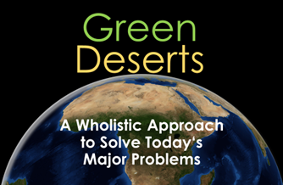






Green Deserts –
A Wholistic Approach to Solve Today’s Major Problems
Kenitra, 2026
The 4th Edition of the International Conference on Climate Nexus Perspectives
Session VI: Climate Water Food Energy Nexus
By: Guido BOHMANN, Green Deserts
Chirhalli LABAIHI, Cooperativa Khat Enadia
Presentation:
Poster:
Website:

Slide 2

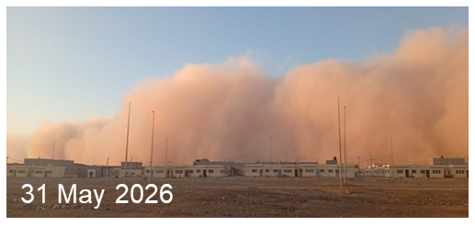
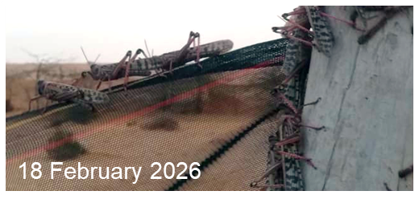
Introduction
How to green deserts?
Create an artificial soil from shifting sands
Enrich the artificial soil with basic nutrients
(especially C_{org} and N_{org})
Cultivate the soil in a solar greenhouse as a
closed environment to easily control 24/7
- sun irradiation or lighting
- ambient temperature
- irrigation rate & air humidity
- pests (e.g. fungi, lice, locusts)
Grow crops or native plants, at least succulents
Irrigate plants with desalinated sea water

Slide 3

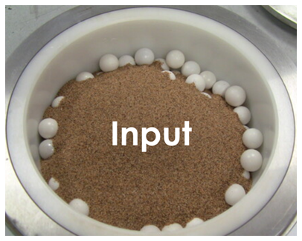
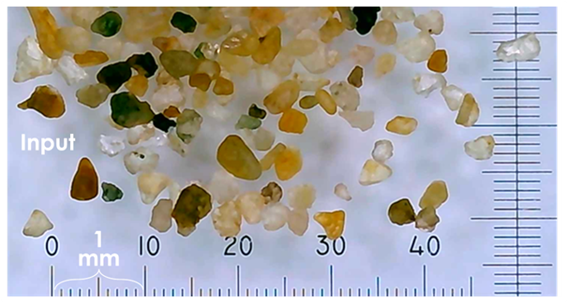
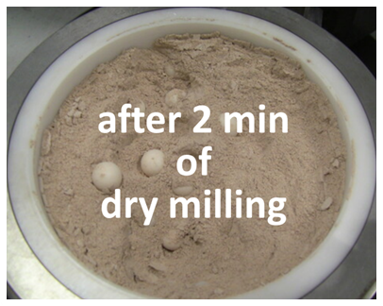
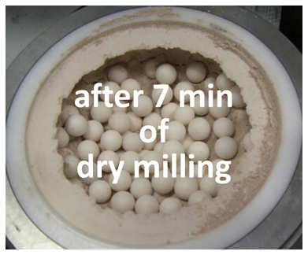
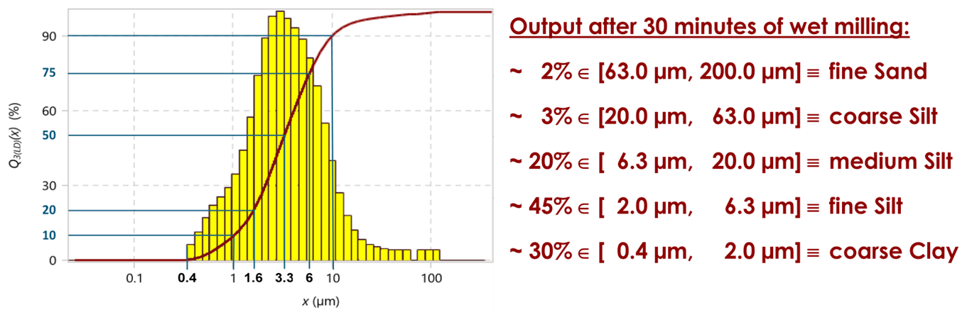
Methodology
How to create artificial soils?

Slide 4

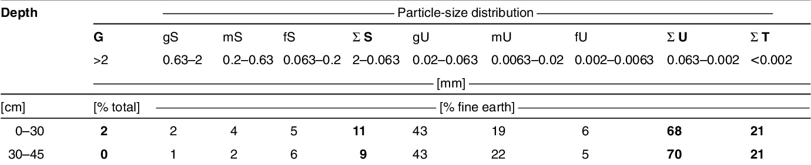
Methodology
How to create artificial soils?
Chernozem
WM30m 2 3 20 45 30

Slide 5

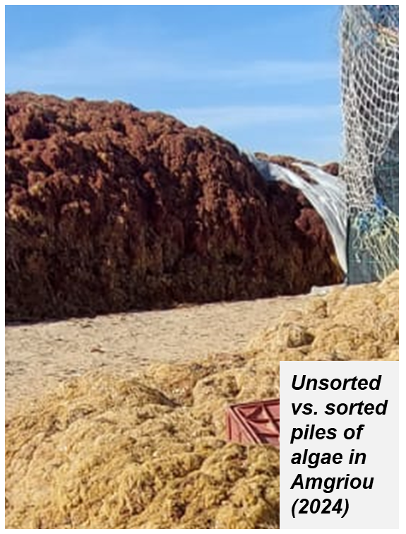
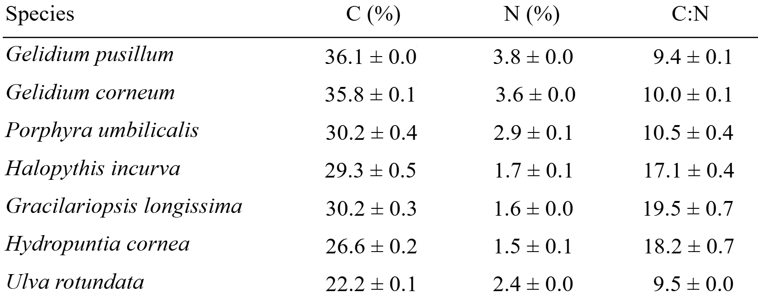
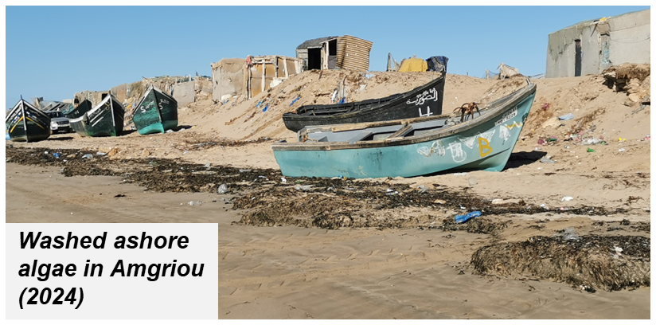
Methodology
How to enrich soils with locally available nutrients?
% of dry weight

Slide 6
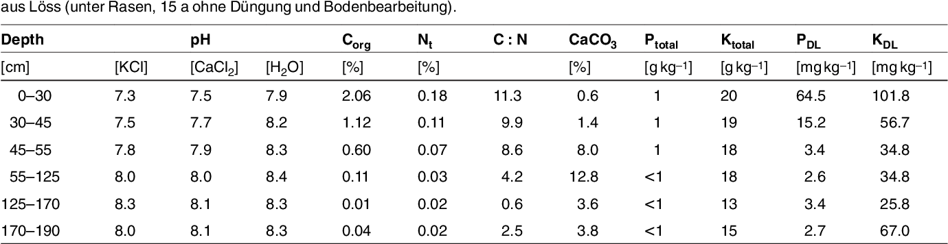
Methodology
How to enrich soils with locally available nutrients?
% of dry weight
Mix
1 g
of
blended algae
Chernozem
with
9 g
of
milled soil

Slide 7
Methodology
How to enrich soils with locally available nutrients?
% of dry weight
Mix
2 g
of
blended algae
Mix
1 g
of
blended algae
Chernozem
with
9 g
of
milled soil
with
8 g
of
milled soil
to ‘fixate’ more carbon!

Slide 8

Poster Session VIII:
Food Systems “Aquaculture and fishery resources /
Coastal risks and marine biodiversity”
Mahjoub EL Bouhouch & Adil Aghzar
”Ecological suitability of the Amégriou region
(South of Tarfaya) for Gracilaria gracilis farming:
An opportunity for the Water–Food–Environment Nexus”
Methodology - Shout out

Slide 9
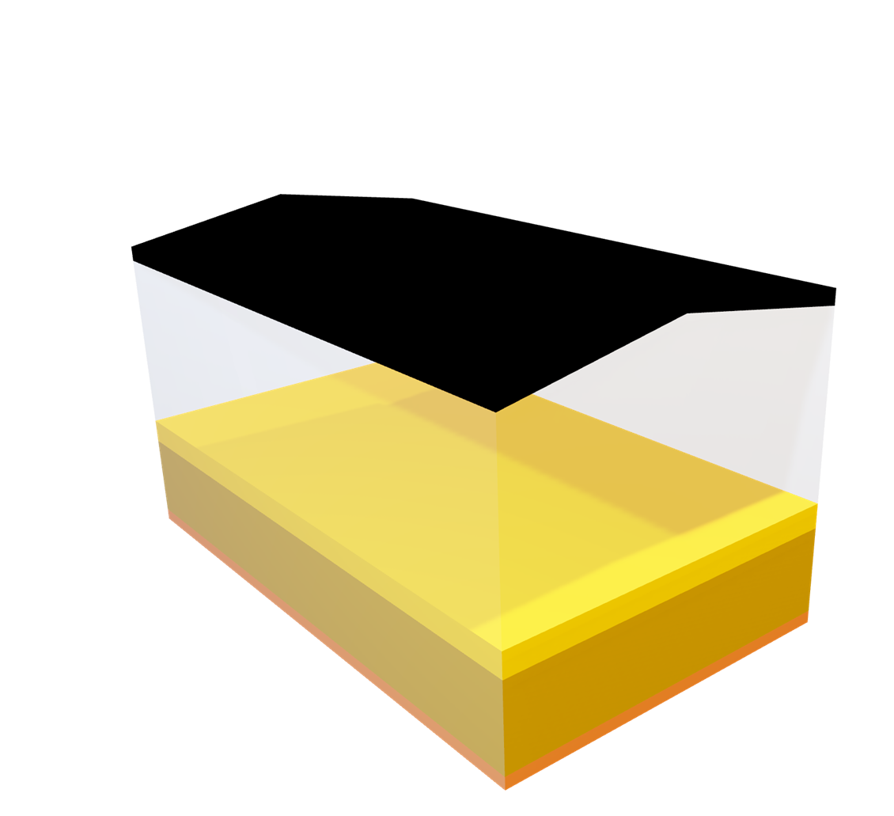
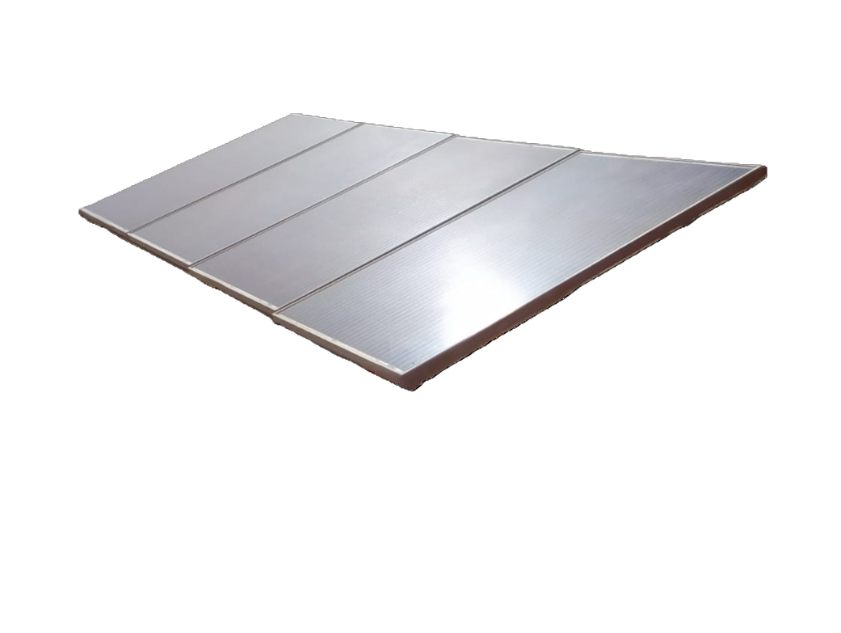
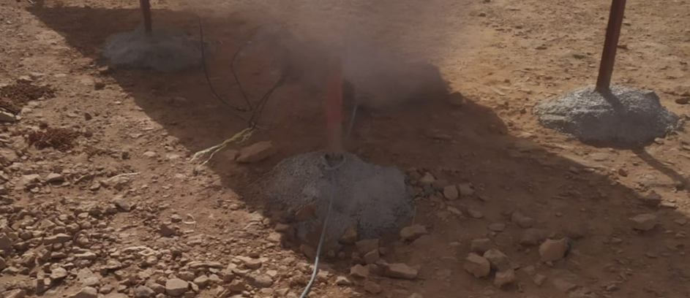
Methodology
Why solar greenhouses?
“Top Level”:
Energy production
for running all the
cooling and irrigation
systems and selling
any surplus
“Main level”:
Crop production
for local consumption
or sale & export
“Base Level”:
Ground conservation
of calcic desert soils
10 m
6 m

Slide 10

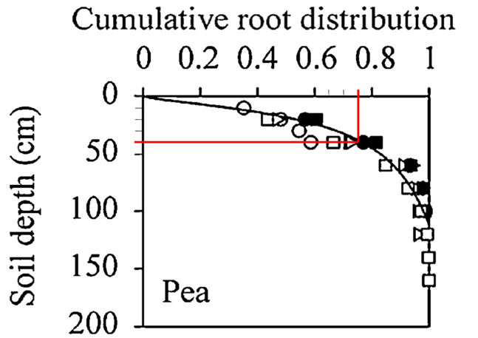

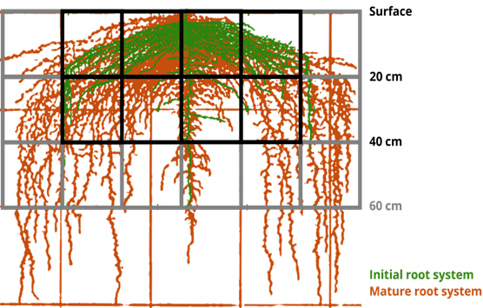


Methodology
How to adjust soil generation according to a planetary mill’s limited output?
“Seed Level”:
Seedling propagation
does not afford an
extreme soil depth
“Main level”:
Crop production
affords a soil depth
according to the
crop to be grown
“Succession Level”:
Soil progression
results in a combination
of multiple ‘aged’ layers
after:
after:
of peas

Slide 11
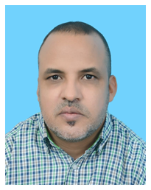
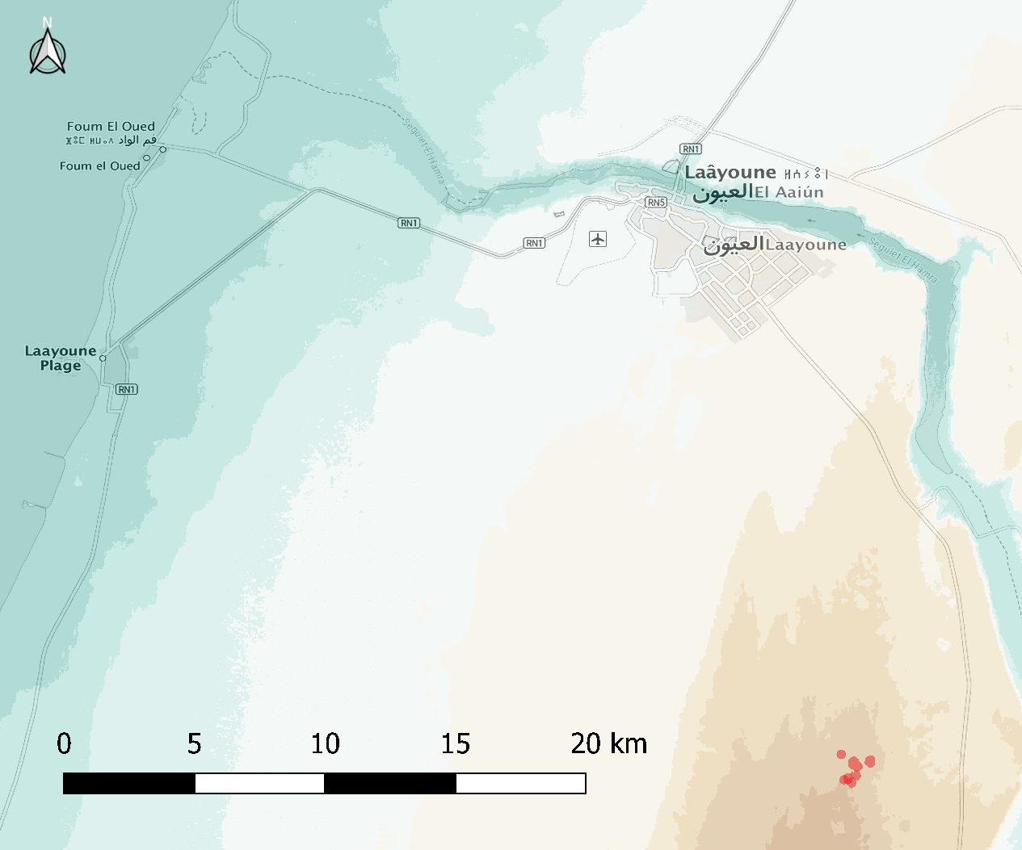
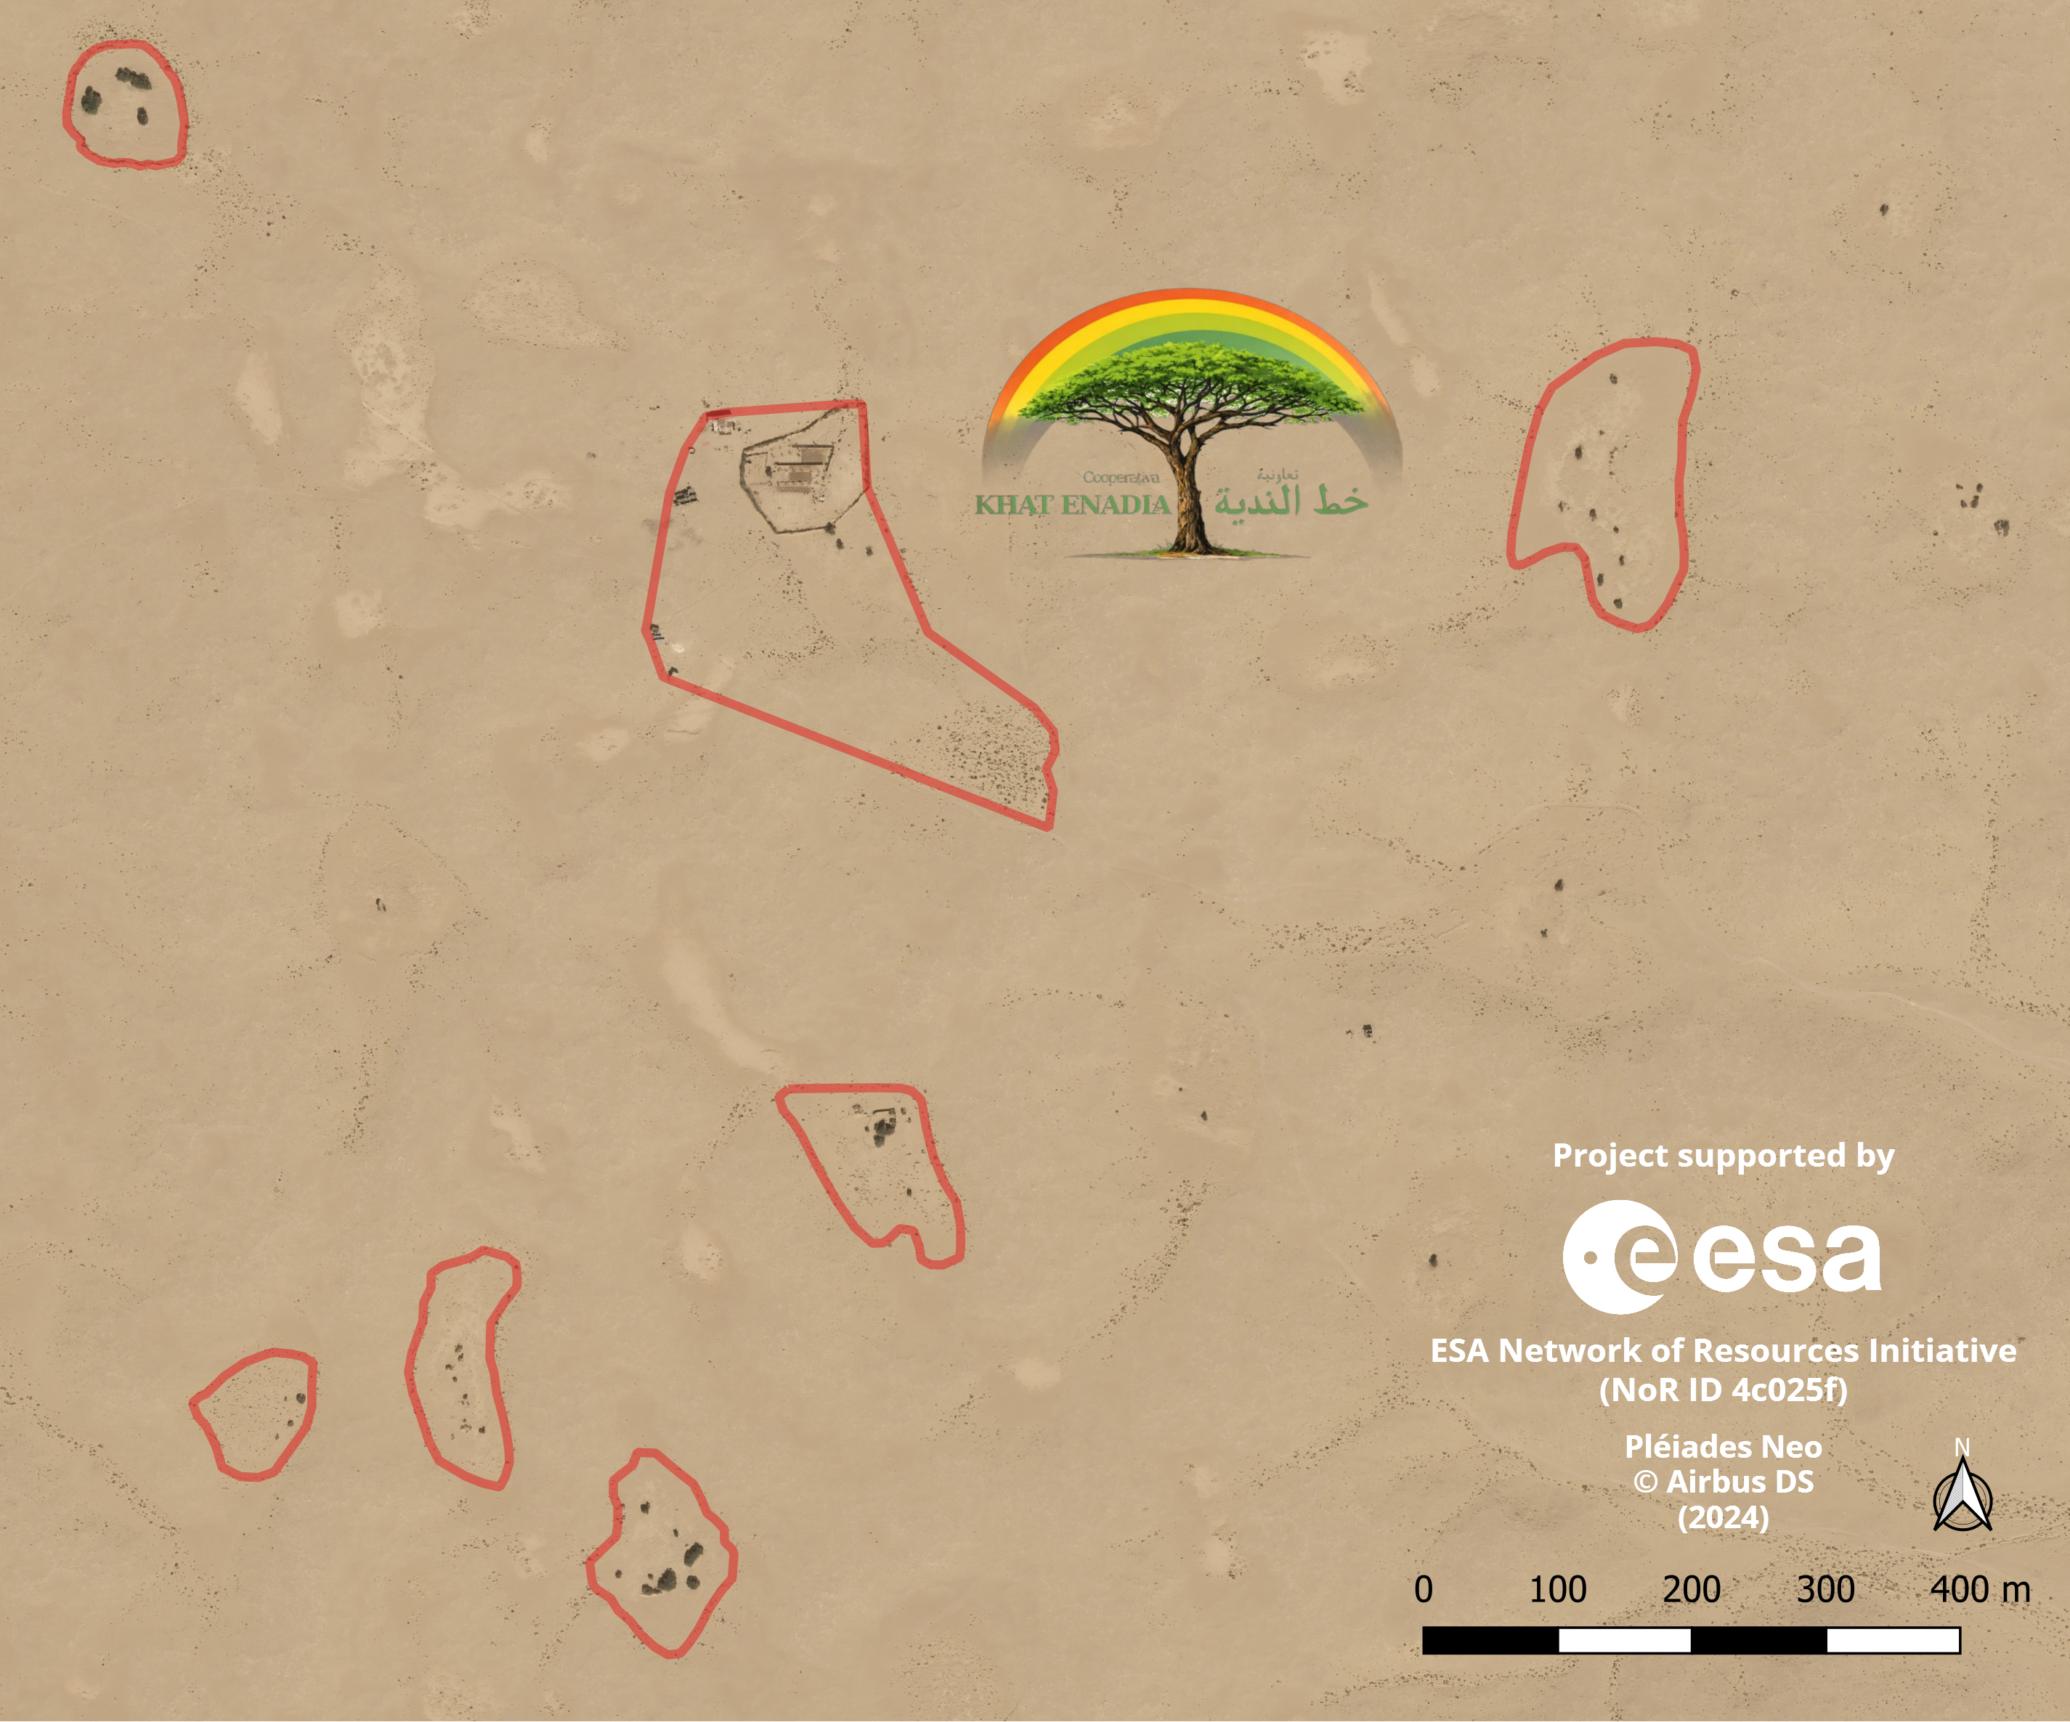
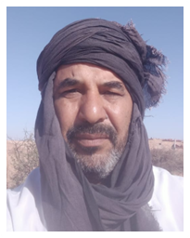

Results
To be achieved @ Cooperativa Khat Enadia … due to missing funds to be applied for yet
Chirhalli
LABAIHI
(President)
شيغالي
لبيهي
Sidi-Amou
LABAIHI
سيدامو
لبيهي

Slide 12
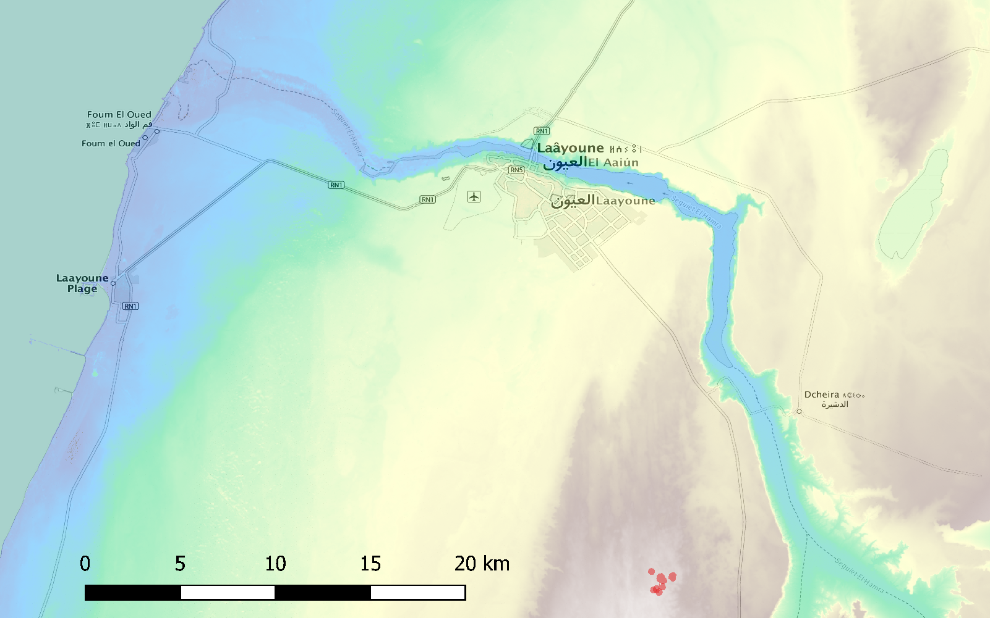

Testing grounds

Slide 13
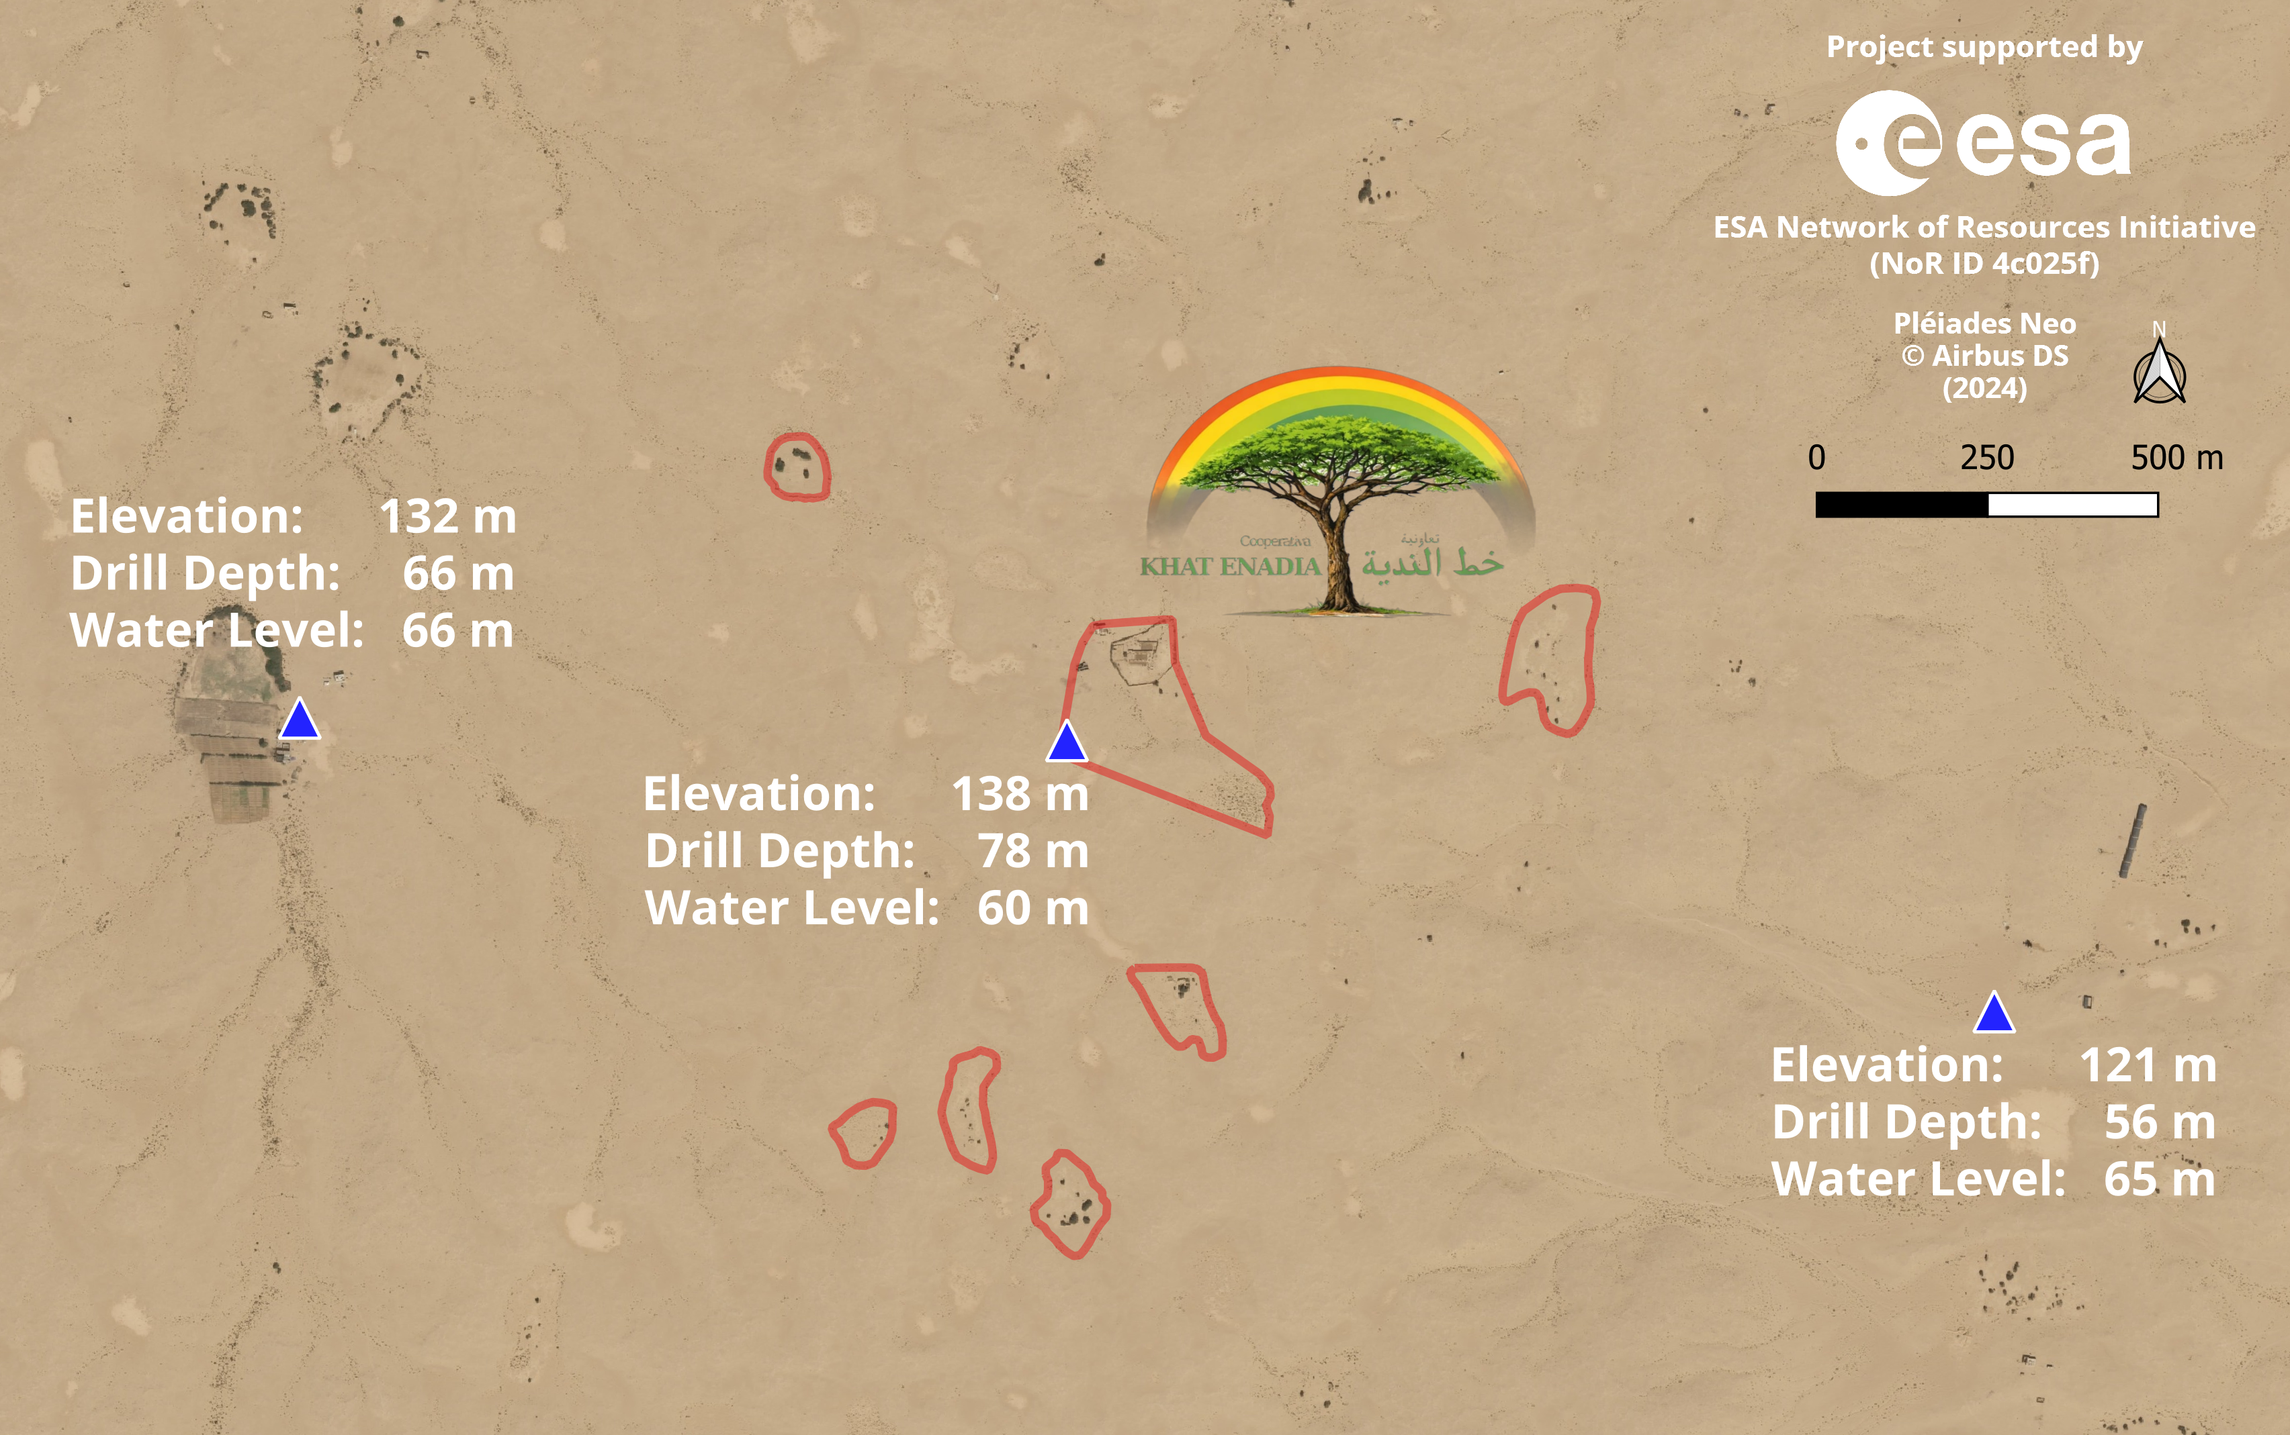
Testing grounds

Slide 14
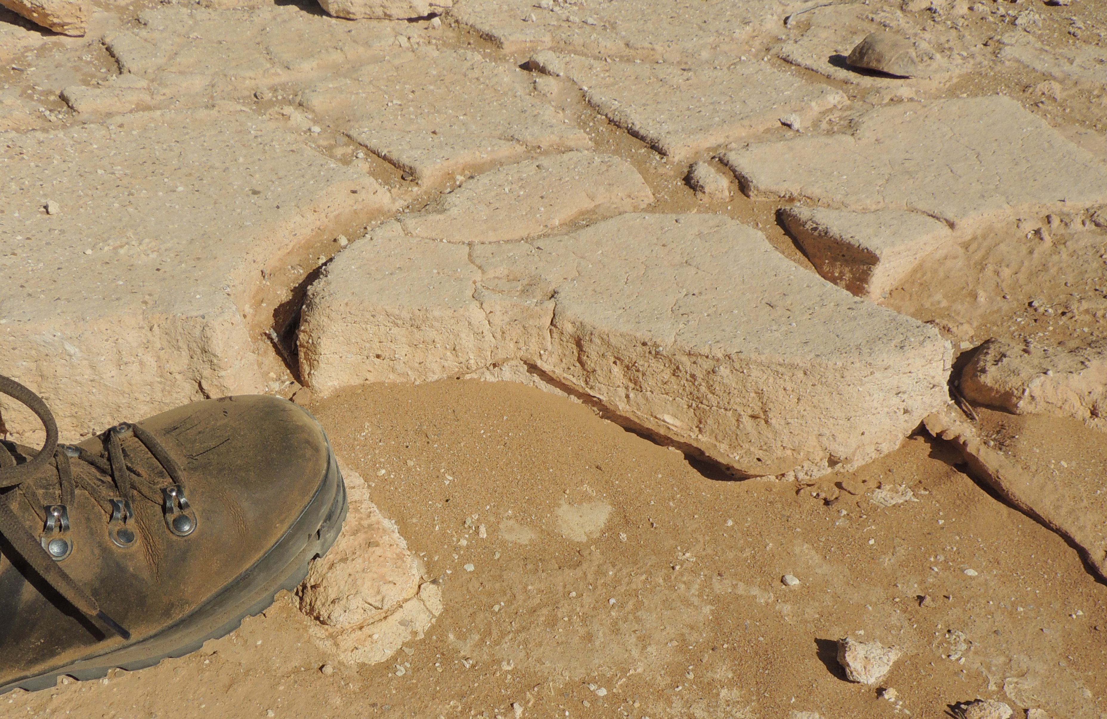
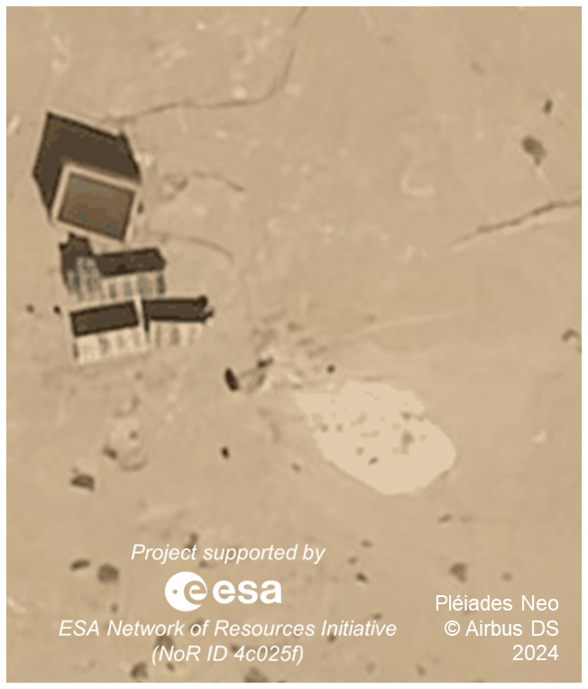
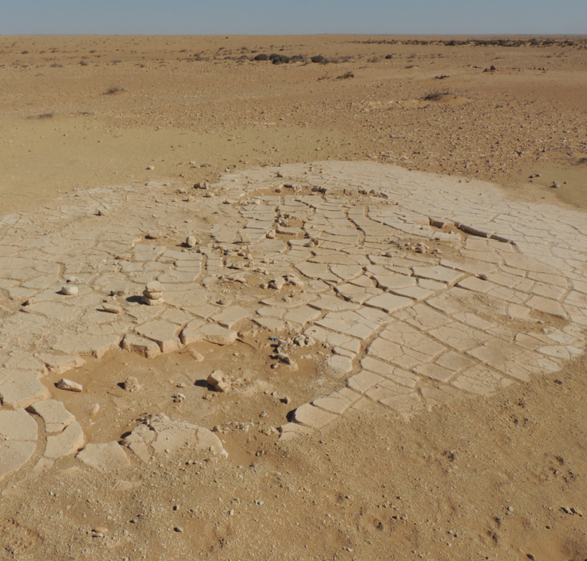
Testing grounds
Plugged calcic horizon

Slide 15
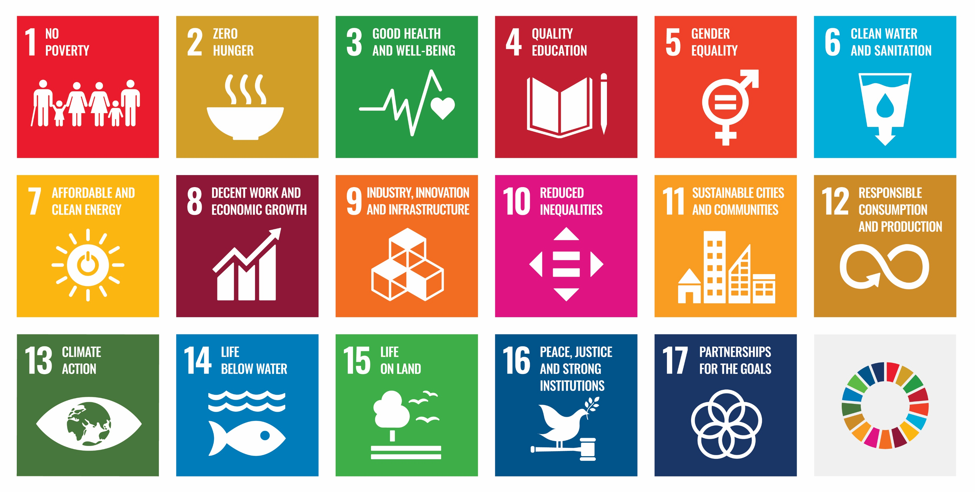


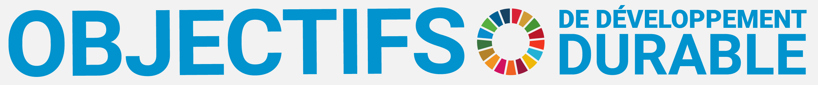

Conclusion
Is the concept sustainable?

Slide 16
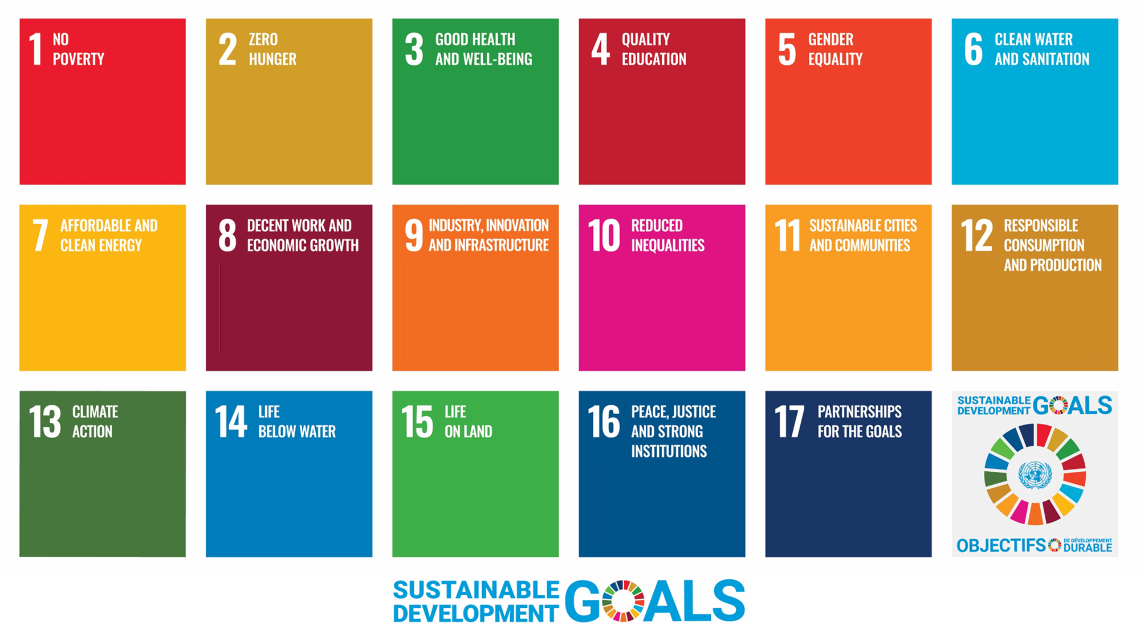
Conclusion
Is the concept sustainable?
New jobs in the
production
of sellable
crops & energy
Additional
production
of crops
Production of
protein crops;
Income to pay
for health care
Tech-based
workplaces
for all levels
of education
Work and
research
open to
any gender
More plants for
desalination &
wastewater
treatment
Plants of solar
greenhouses
Workplaces in
the production
and sale of
crops & energy
Tech-based
workplaces on
plants of solar
greenhouses
Selling crops &
energy needed
in industrial
countries
Operation of
solar green-
houses =
community task
Production of
sustainable
crops & energy
Sustainable
energy &
carbon dioxide
fixation
Growing algae
for CO₂ fixation;
Removal of
microplastics
Growing earth
worms for soil
fertility & CO₂
fixation
Sustainable
‘industry’ as
stability factor
Producing and
selling crops &
energy as CO₂
allowances

Slide 17
Conclusion
Is the project sustainable?
LESS
LESS
✓
✓
✓
✓
✓
✓
✓
✓
✓
✓
✓
✓
✓
✓
✓

Slide 18


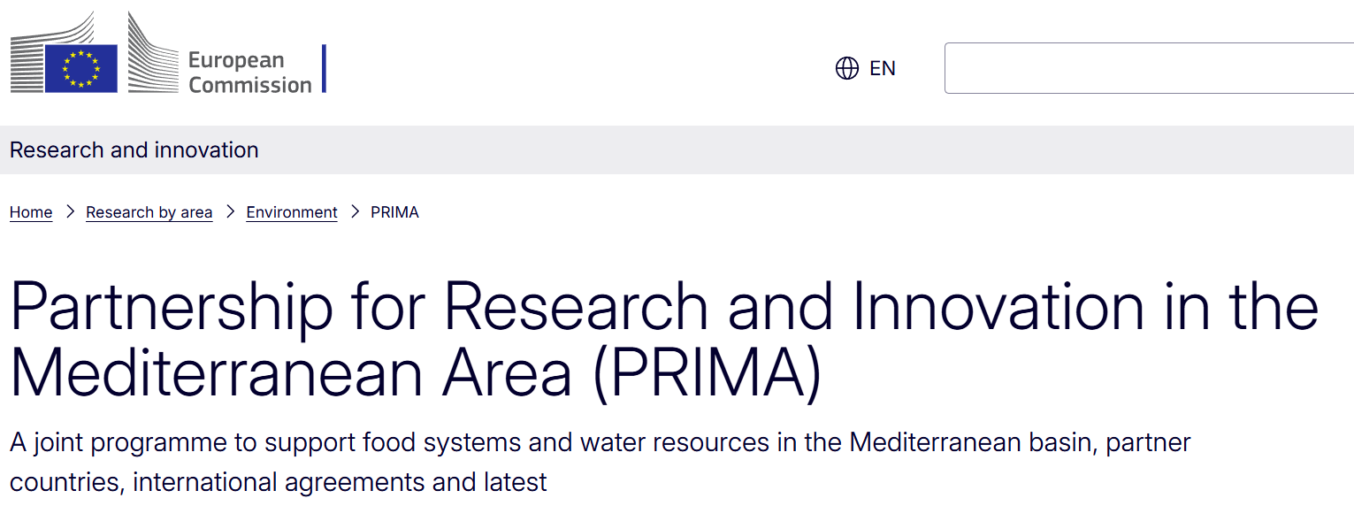

Conclusion
Partnership for the goals?

Slide 19
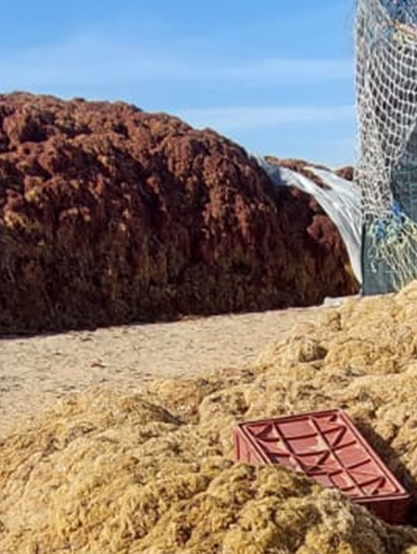
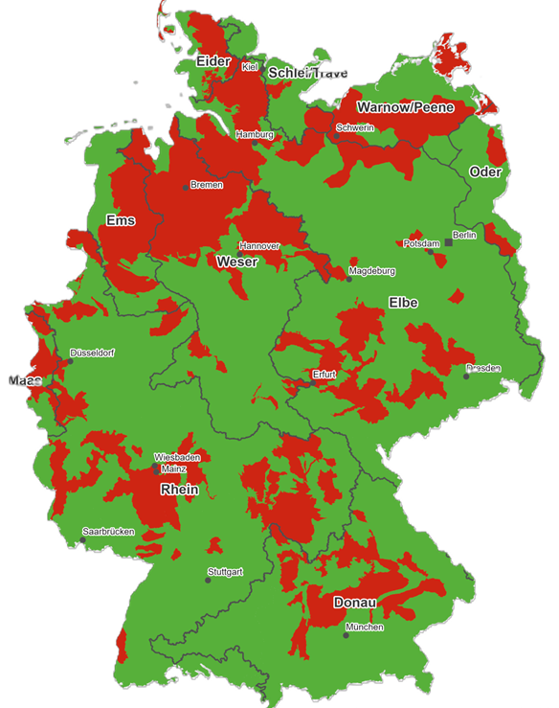

Conclusion
What scale of partnership?
Utilisation of Import of
local resources foreign overflows
Unsold or Ground
unsellable water
piles of nitrate
algae in pollution in
Amgriou Germany
(2024) (2022)

Slide 20




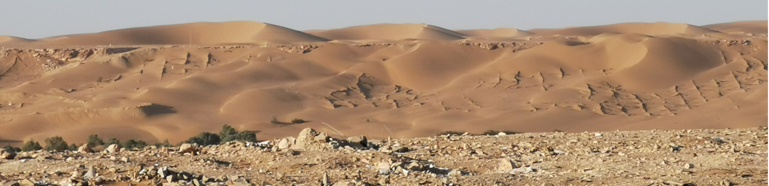

Thank you !
Guido Bohmann
E-mail: guido.bohmann@
green-deserts.net

Slide 21
Additional Sheets
(maybe helpful for Q&A session)

Slide 22


Introduction
Who is behind „Green Deserts“?
1997
-
2002: Degree in Environmental Sciences |
Diplôme en sciences de l'environnement |
دبلوم في علوم البيئة
2008: Research associate @ Fraunhofer Society |
Chercheur associé @ Société Fraunhofer |
باحث مشارك في جمعية فراونهوفر
- 2011
Guido
BOHMANN
*1972
2011: Doctoral degree in Informatics |
Doctorat en informatique |
دكتوراه في المعلوماتية
2018: Research Coordinator @ Robert Koch Institute |
Coordinateur de recherche @ Institut Robert Koch |
منسق أبحاث في معهد روبرت كوخ
- 2020
2020: Member of Mensa | Membre de Mensa | Mensa عضو في منظمة
2023: Co-Winner of the 'The 1% Club' (German version) |
Co-lauréat du prix «The 1% Club» (version allemande) |
النسخة الألمانية)) ” The 1% Club“ الفائز المشترك بجائزة

Slide 23

Introduction
Why “wholistic”?
We want to enable people to make a living at any place they call
home. Not only but especially in desert regions. Therefore,
we want to create sustainable working spaces in which
locals can work and study in demanding settings
whilst cooperating with the people of the world on
coping with shared or other local problems.
20th century: “Think global, act local”
21st century: “Think local, act global”
We want space, water, nutrients, energy as well as all
resources to be use in an efficient and economical way.
We want to address the whole picture. In addition, we
do not want the project to become another black hole
in which funds and working power got wasted away.

Slide 24
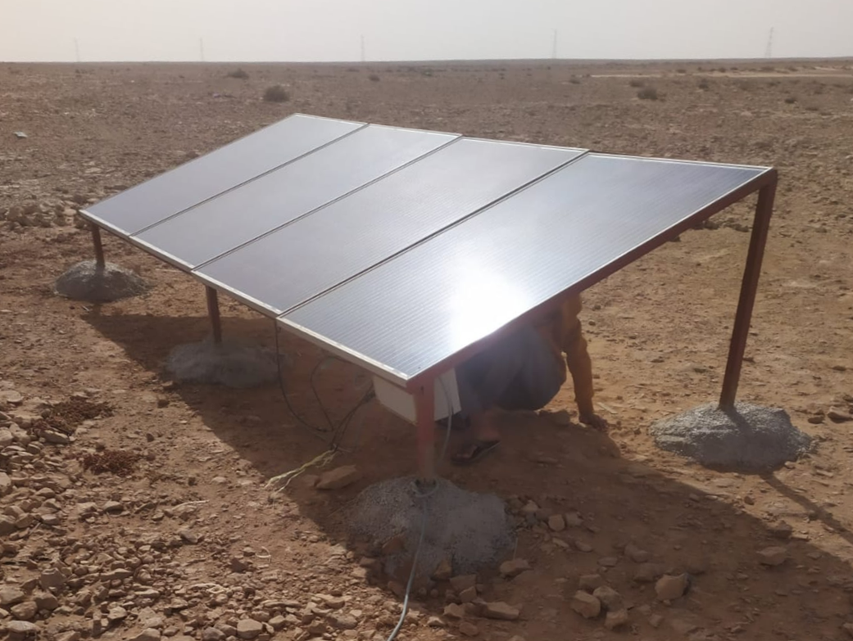
Introduction
Why deserts?
Lots of sun irradiation
⇨ free source of
sustainable energy
Lots of „unused“ space
⇨ “free” for large-sized
agro-industrial (power)
production plants

Slide 25
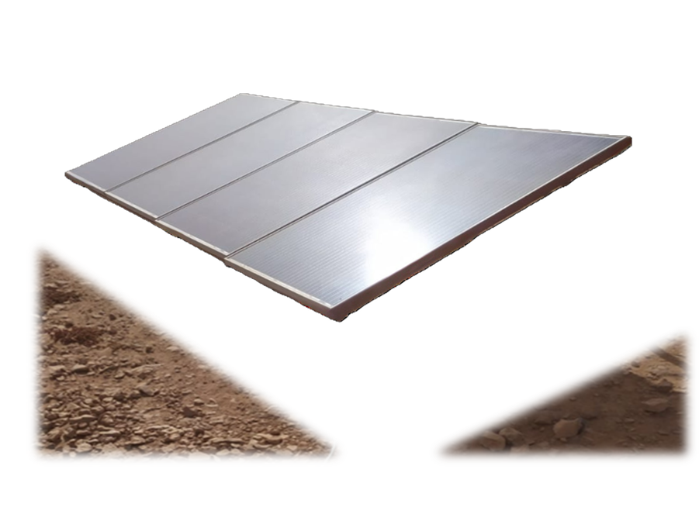
Introduction
Why deserts?
Lots of sun irradiation
⇨ free source of
sustainable energy
Lots of „unused“ space
⇨ “free” for large-sized
agro-industrial (power)
production plants

Slide 26

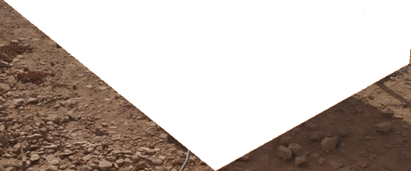
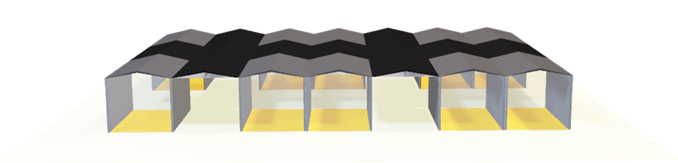
Introduction
No need to waste space!
Energy production
Crop production

Slide 27
Methodology
Why solar greenhouses?
Closed environment:
Crop production can be
assured by controlling
parameters more easily
Multipurpose:
Buildings are usable as
working or living spaces
for personnel running
adjacent greenhouses
Reusability:
Greenhouses can be turned
into e.g. schools if needed
or if surplus is generated

Slide 28
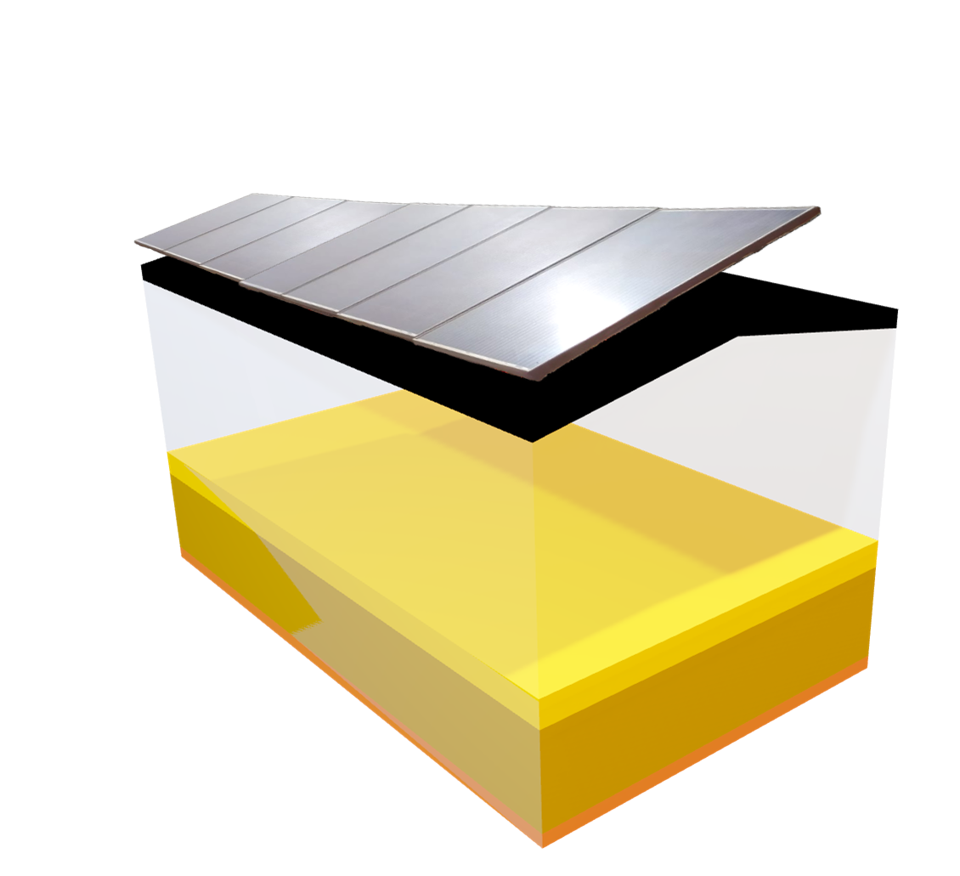
Methodology
Why solar greenhouses?
Scalability:
Using standardised building blocks
usually allows a more easily
connection and thus extension
of a system

Slide 29
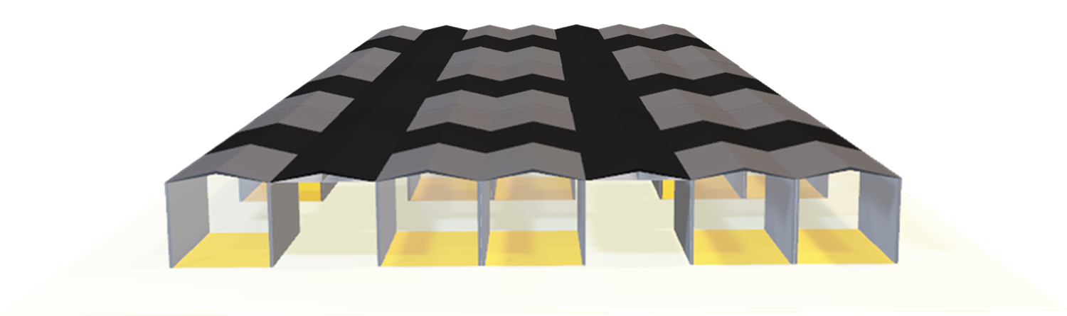

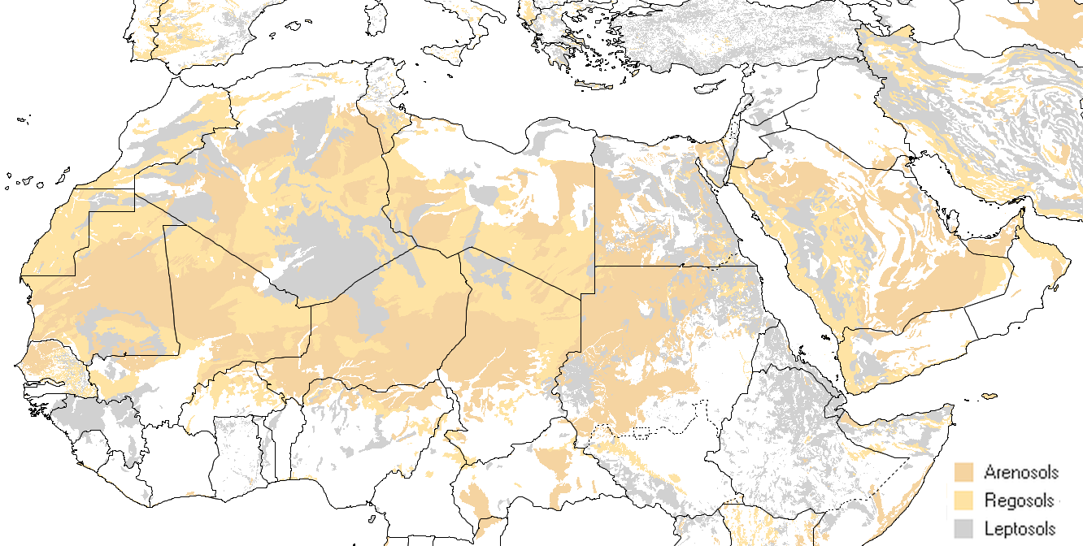
Introduction
Why deserts?
Lots of sun irradiation
⇨ free source of
sustainable energy
Lots of „unused“ space
⇨ “free” for large-sized
agro-industrial (power)
production plants
Lots of sand
⇨ “free” natural resource
Lots of calcic grounds
⇨ carbon dioxide storages
which are to be conserved

Slide 30
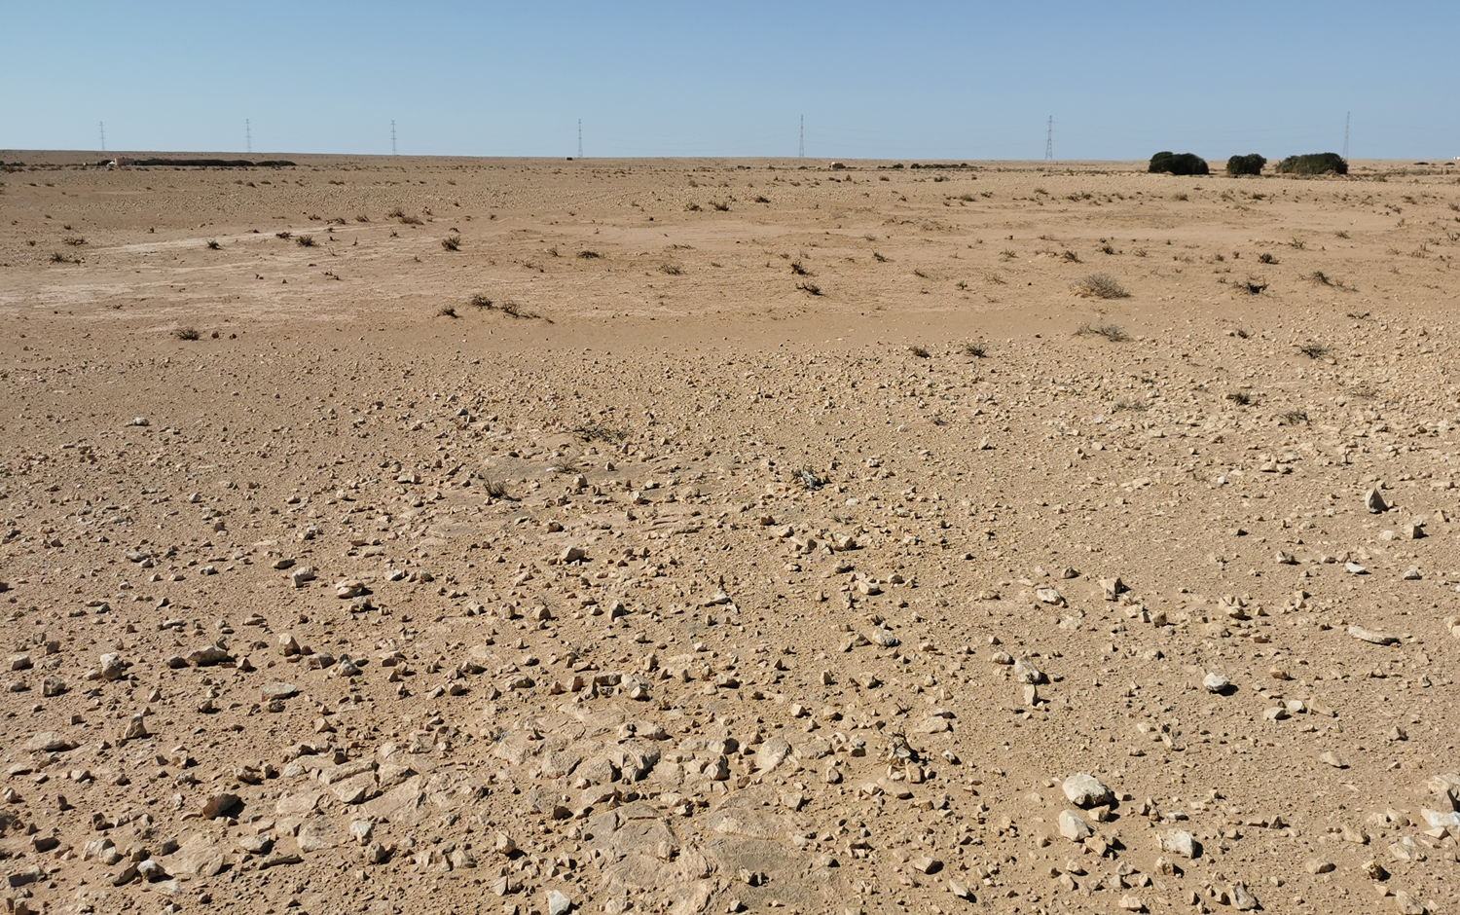
Introduction
❹
❶
❷
❸
❺

Slide 31
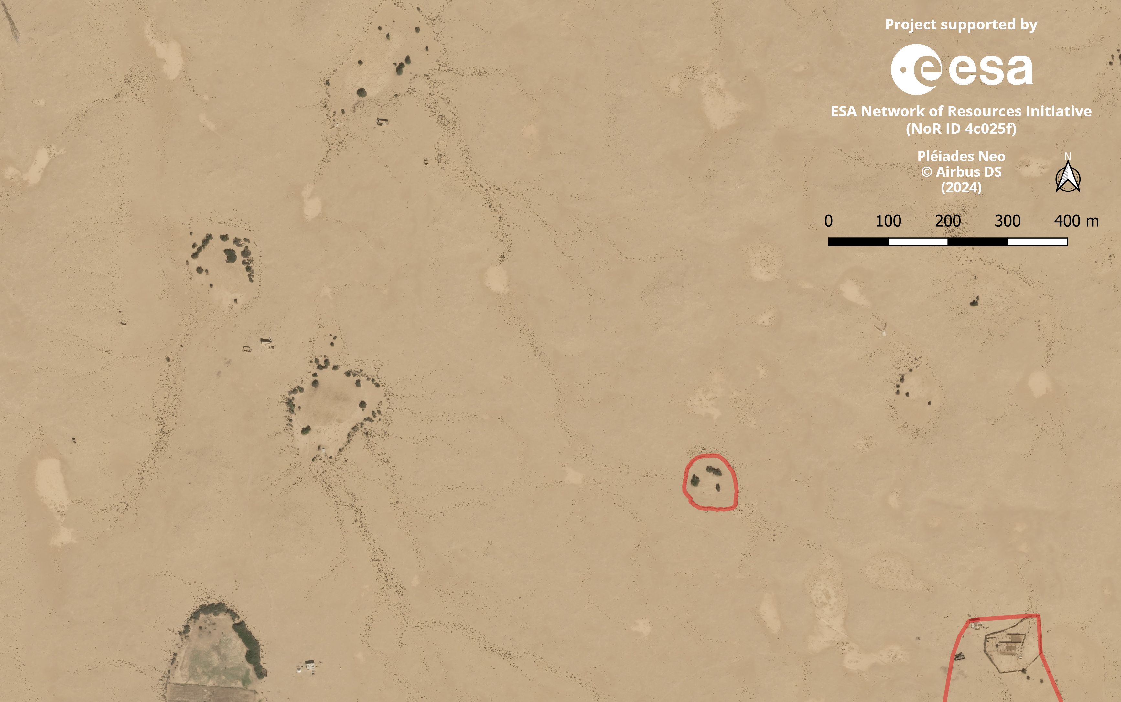
Introduction
❹
❸
❷
❺
❶

Slide 32
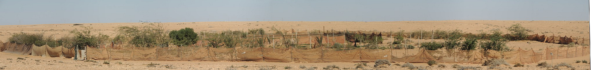
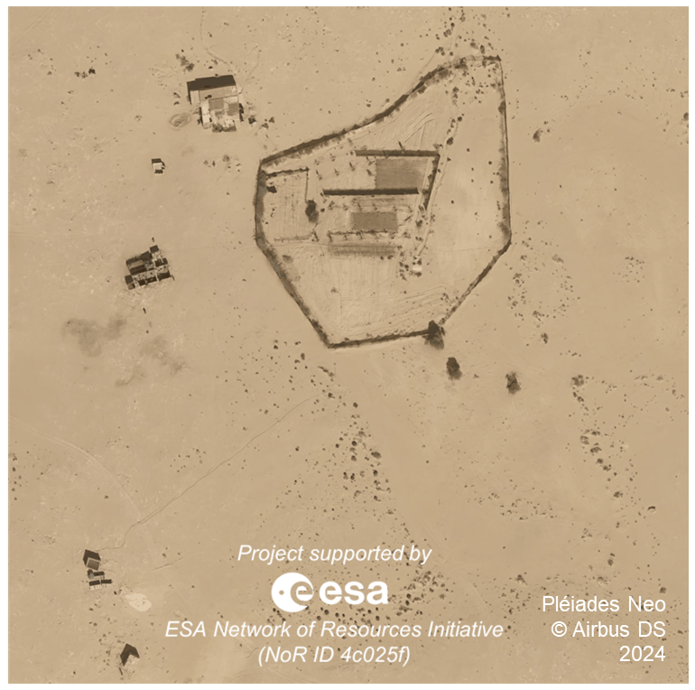
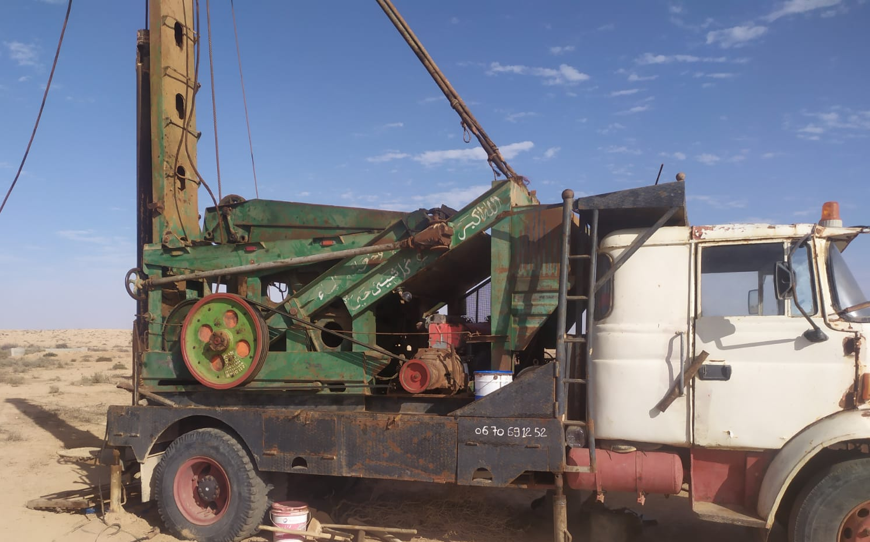

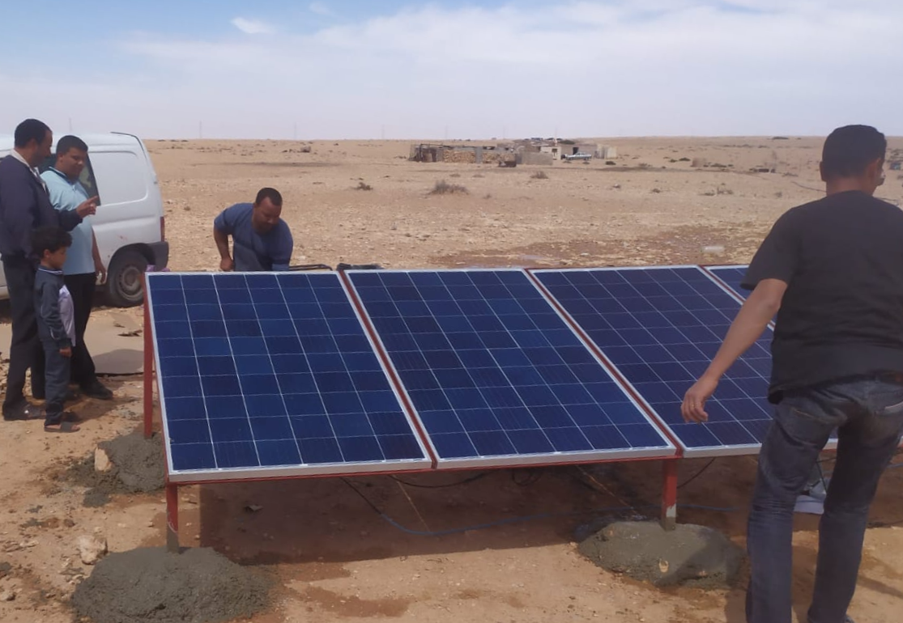
Introduction
Why desert regions?

Slide 33
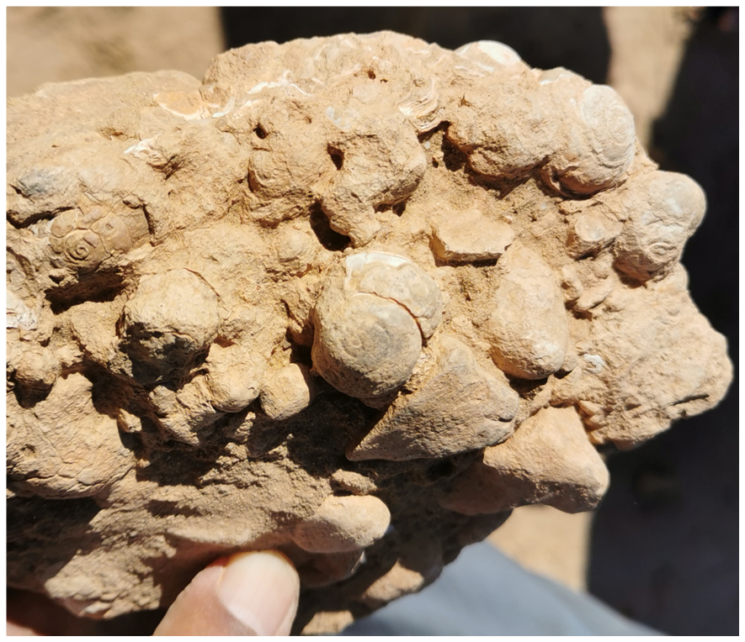
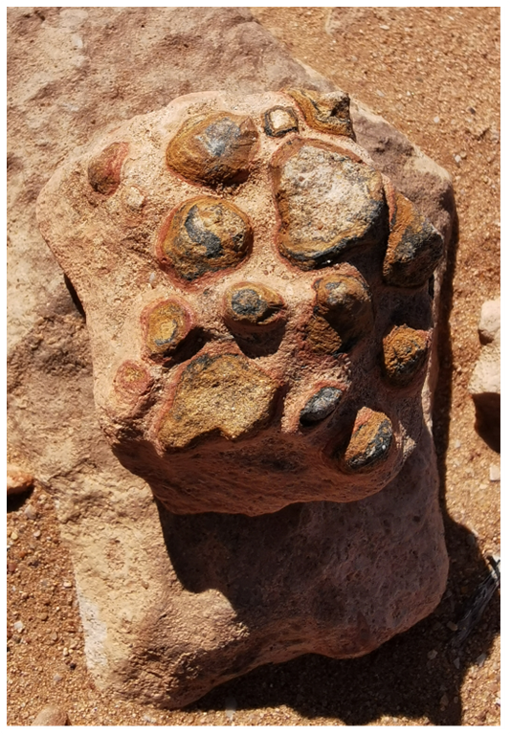
Introduction
Biogenic lime sediments

Slide 34
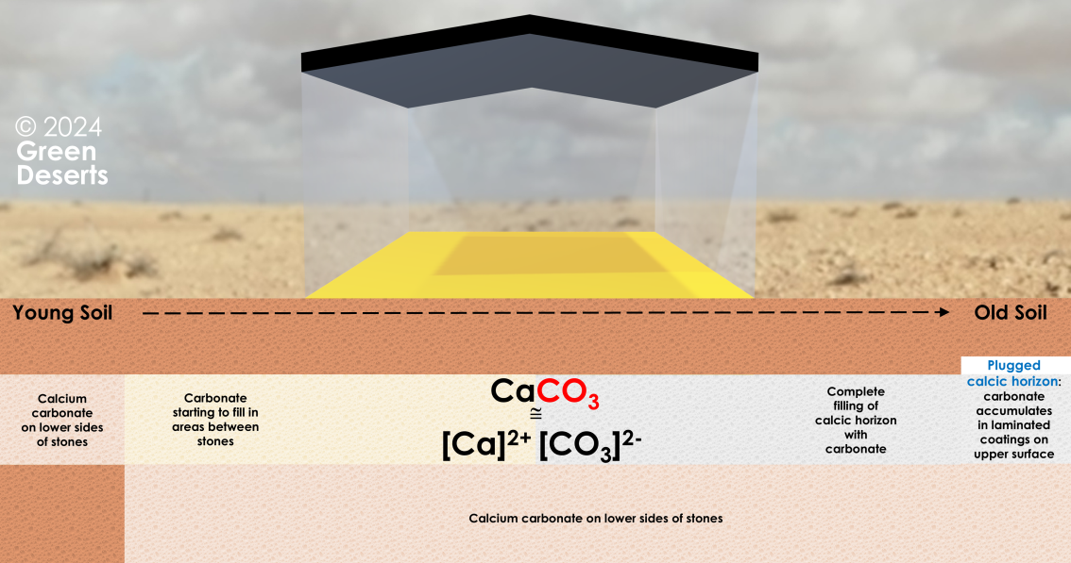

Introduction
Conservation of already fixated carbon dioxide

